Slide 1
Front Propagation through a Perforated Wall
Hiroshi Matano
（Meiji University)
Partial Differential Equations Conference
University of Athens, 10--12 June, 2025

Slide 2
Outline
Introduction
Formulation of the problem
Propagation / blocking dichotomy
Sufficient conditions for blocking
Sufficient conditions for propagation

Slide 3

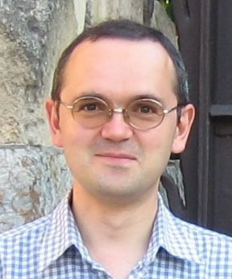
Introduction
Joint work with
Henri Berestycki (EHESS)
François Hamel (Aix-Marseille)

Slide 4
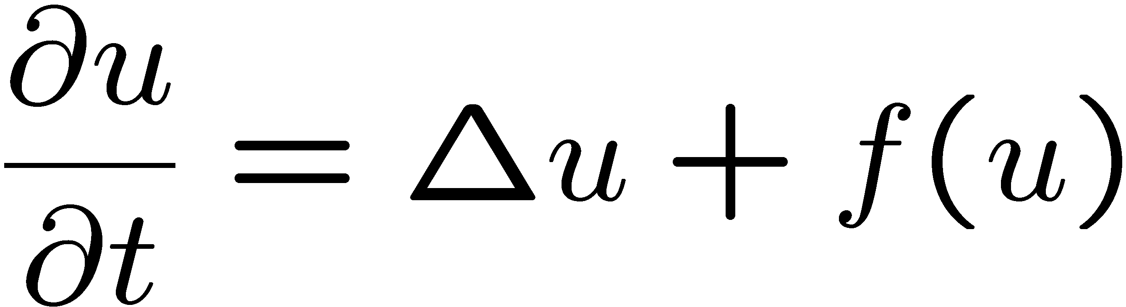

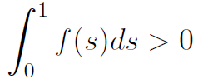


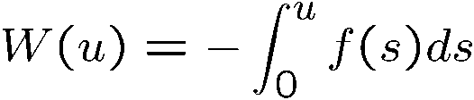
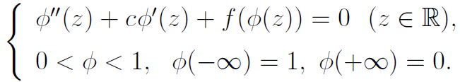


Bistable RD equation
f (u)
u
0
$$α$$
1
on
f (u): bistable
Existence of traveling wave
unbalanced
1D
1
potential
0
x
front
$φ$: TW profile
0
u
1
unequal well-depth
Fife & McLeod (ARMA1977)

Slide 5

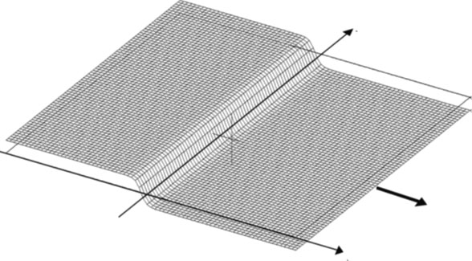


Bistable RD equation
f (u)
u
0
$$α$$
1
on
f (u): bistable
Existence of traveling wave
unbalanced
$$N≥2$$
Planar wave
$$y$$
Q
What happens if there is an obstacle?

Slide 6


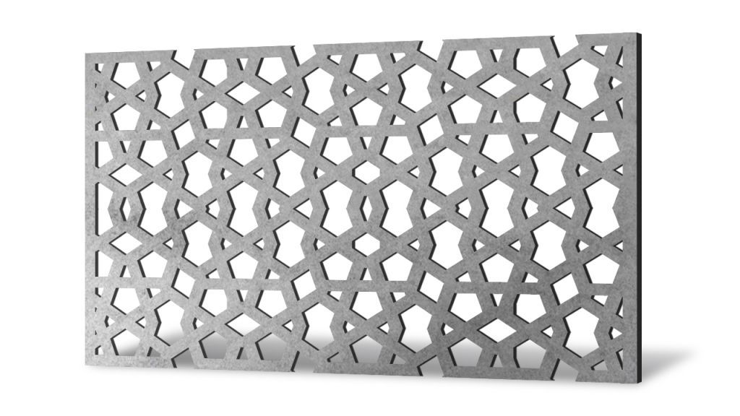
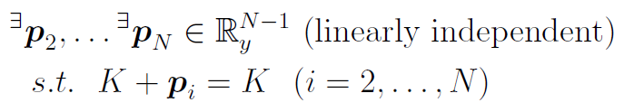
Description of the obstacle
Obstacle (wall)
finite thickness
connected
smooth
0
M
For some results we also assume periodicity in y.
K
1
0
x
front
0
M
Under what conditions can the front pass through the wall?
Q
K

Slide 7
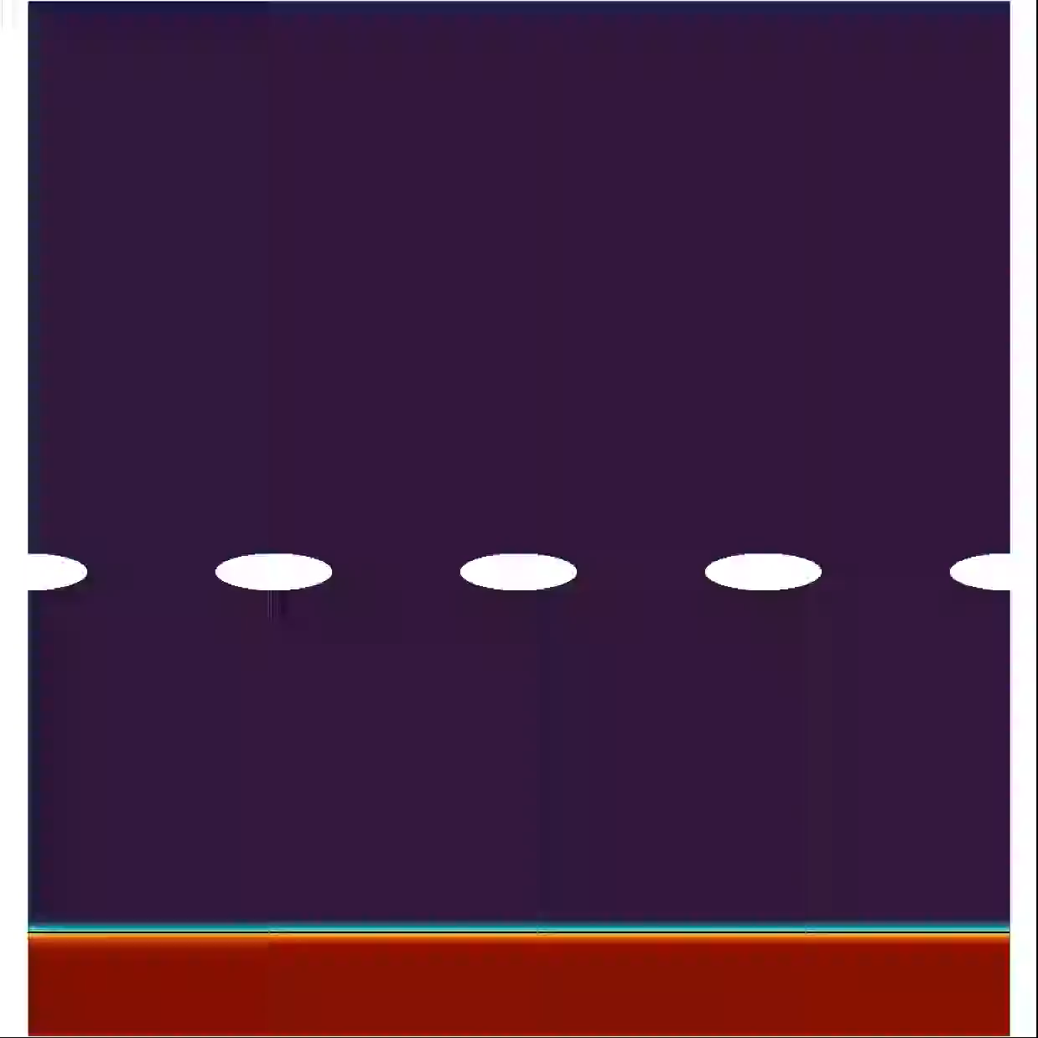
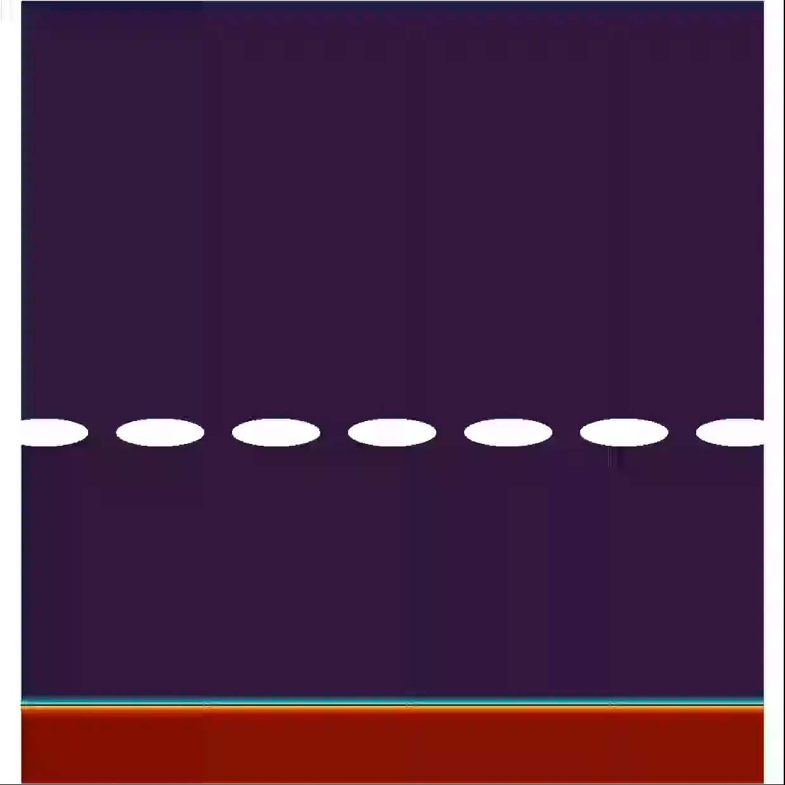
Some numerical simulations
Simulation by Steffen Plunder
(Kyoto University)
Wall with wider holes
Wall with narrower holes
Propagation
Blocking
The front has surface energy.
surface tension

Slide 8
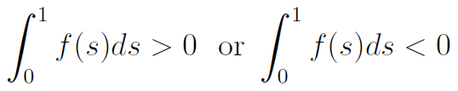



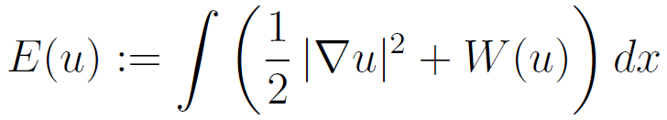

Bistable RD equation & interface motion
f (u)
u
f (u) : bistable
0
$$α$$
1
balanced:
unbalanced:
Interface motion ($N≥2$)
Approximate law of motion
f : unbalanced
V = (N - 1) H + A
V = normal velocity H = mean curvature N = space dimension
A : driving force
outward normal vector
Interfacial energy + bulk energy
Energy

Slide 9
Bistable RD equation & interface motion
f (u)
u
f (u) : bistable
0
$$α$$
1
balanced:
unbalanced:
Interface motion ($N≥2$)
Approximate law of motion
f : unbalanced
V = (N - 1) H + A
0
u
1
unequal well-depth
outward normal vector
Interfacial energy + bulk energy
Energy

Slide 10
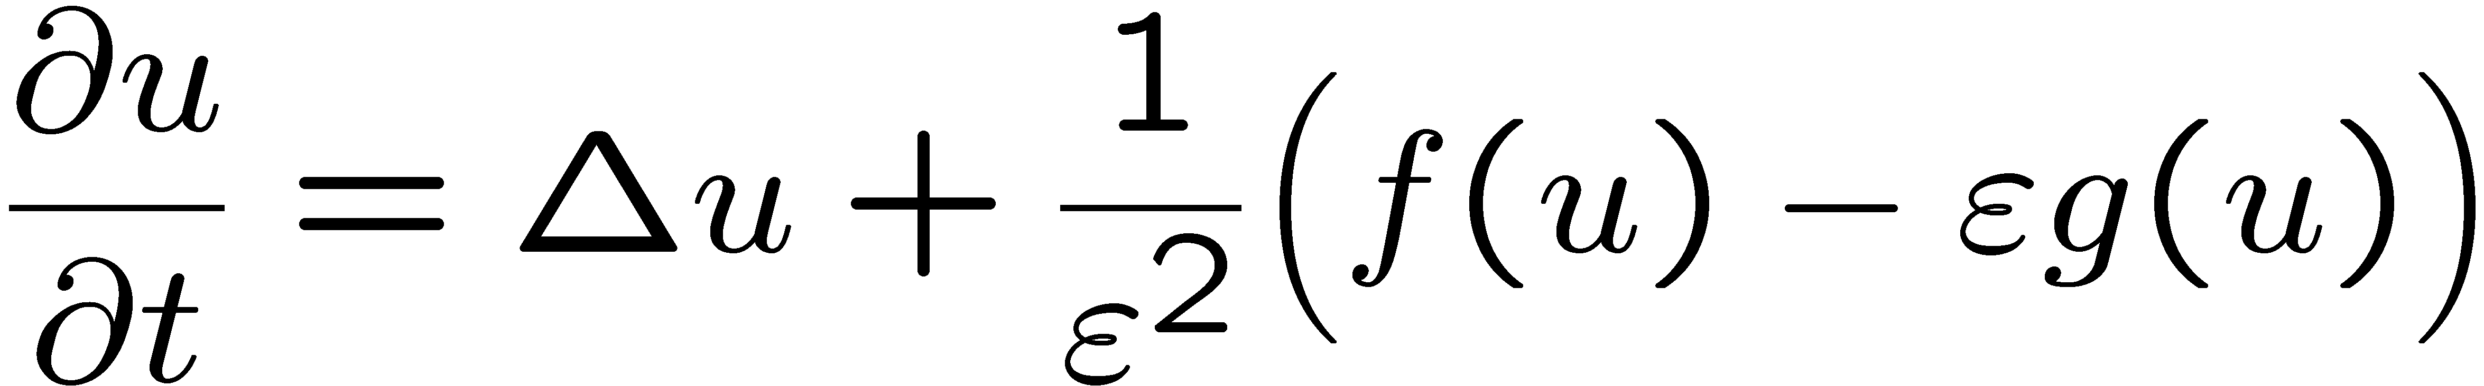
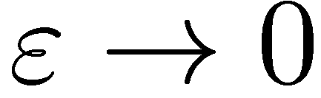

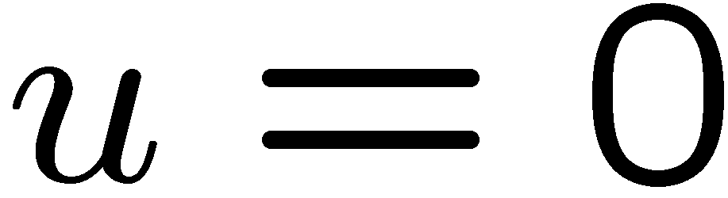
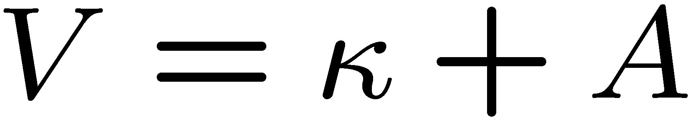
More rigorous approach: sharp-interface limit
Singular limit
mean curvature flow
sharp-interface limit
Transition layer (front)
sharp-interface
front
Expample:

Slide 11
Formulation of the problem

Slide 12
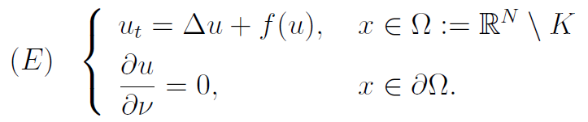
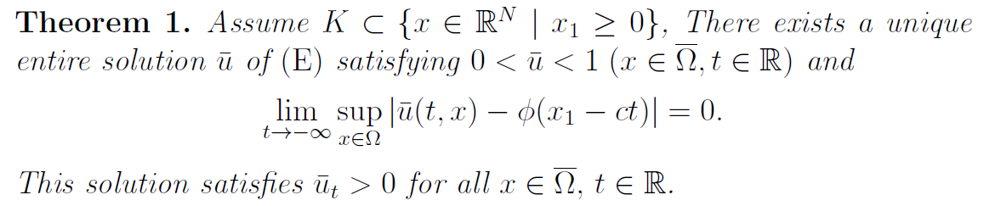

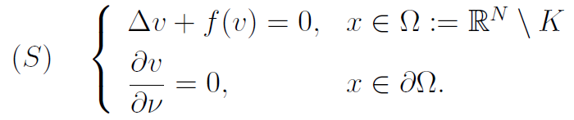
Planar-front like solution
Is there a planar-front like solution that approaches the obstacle K ?
0
M
K

Slide 13
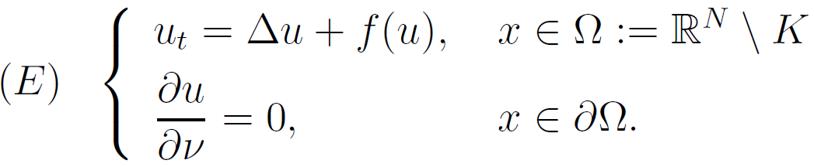
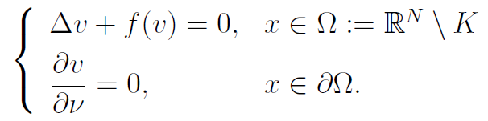


Limit profile
Def
1
1
blocking
propagation
0
0
Q
Find conditions for propagation and those for blocking.

Slide 14
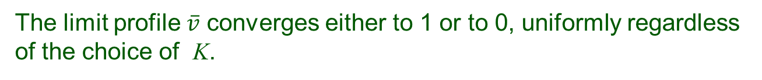
List of main results
Dichotomy theorem
The limit profile $\overline{v}$ converges either to 1 or to 0, uniformly regardless of the choice of K.
Method: Liouville type lemma
The family of blocking walls form a closed set, while that of non-blocking walls form an open set.
Sufficient conditions for blocking.
Blocking occurs if the holes are narrow enough.
Method: variational arguments
Sufficient conditions for propagation.
Wall with large holes;
Small capacity wall;
Parallel blade wall.

Slide 15
Propagation / blocking dichotomy
Classification of solution behaviors beyond the wall.

Slide 16
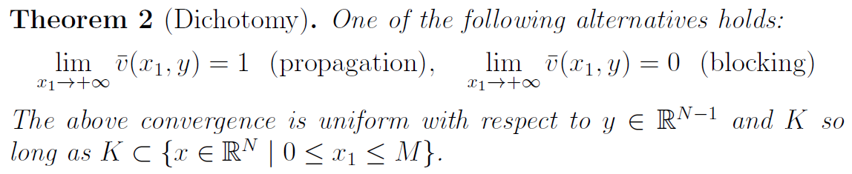
Propagation / blocking dichotomy
In particular, there is no blocking profile that converges to 0 too slowly.
Idea of proof:
Limiting argument
+
Liouville type lemma

Slide 17
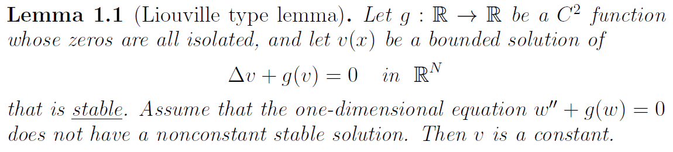
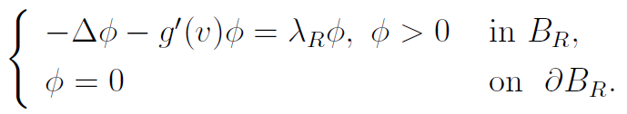

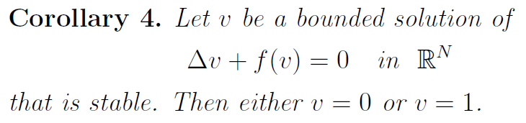
Liouville type lemma
[ Y. Liu, K. Wang, J. Wei, K. Wu: Proc. AMS, to appear ]
Definition of “stability”

Slide 18
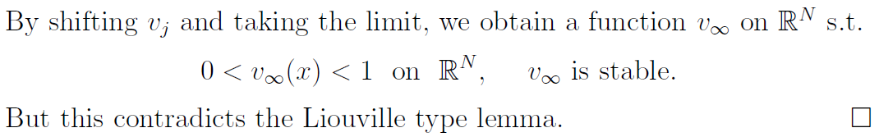
Outline of the proof of Theorem 2
Remark
Stability is preserved by spatial shifts and by limiting procedures.

Slide 19
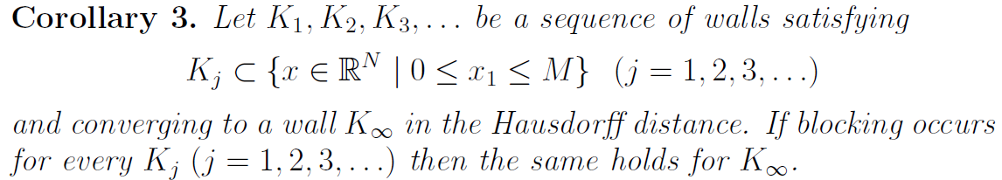


Propagation / blocking dichotomy

Slide 20
Conditions for blocking
Geometric obstruction

Slide 21
Theorem 5. Assume either of the following:
(K1) K is periodic in y.
(K2) The holes are localized in a bounded region.
If the holes are too small, then blocking occurs.
Idea of proof
Construction of an upper barrier by variational methods.
Related earlier works.
[M. 1979]
[Berestycki-Bouhours-Chapuisat 2016]
(M 1979)
(BBC 2016)

Slide 22
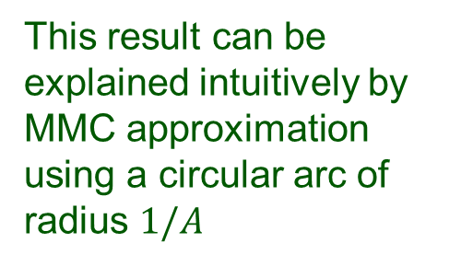
Theorem 5. Assume either of the following:
(K1) K is periodic in y.
(K2) The holes are localized in a bounded region.
If the holes are too small, then blocking occurs.
Remark
The assumptions (K1) and (K2) allow us to define an energy functional around the holes. The problem is open without these conditions.
Whether blocking occurs or not does not simply depend on the size of the holes. As shown in [BBC 2016], blocking occurs if the opening angle is large, but not if the opening angle is small.
This result can be explained intuitively by MMC approximation using a circular arc of radius $1/A$
NOT upper barrier
Upper barrier

Slide 23
Theorem 5. Assume either of the following:
(K1) K is periodic in y.
(K2) The holes are localized in a bounded region.
If the holes are too small, then blocking occurs.
One-way blocking
(A) Narrow exit and large opening angles
(B) Narrow entrance but wide exit, and small opening angles.
K
K
Blocking
Propagation

Slide 24
Sufficient conditions for propagation
Three types of walls

Slide 25
Walls that allow propagation
(a) Wall with large holes
A ball of a critical radius R₀ can pass through one of the holes, where R₀ is to be specified later.
(b) Small capacity wall
K is close to a set of capacity 0 in Hausdorff distance.
(K_{ε} is in the ε neighborhood of a zero capacity set K₀.)
(c) Parallel-blade wall
K consists of thin panels parallel to the x₁ axis. More precisely, K₀ is a locally finite union of hypersurfaces parallel to the x₁ axis and let K_{ε} converge to K₀ in a certain sense.

Slide 26
Walls that allow propagation
(a) Wall with large holes
A ball of a critical radius R₀ can pass through one of the holes, where R₀ is to be specified later.
Method: comparison principle and sweeping argument
(b) Small capacity wall
K is close to a set of capacity 0 in Hausdorff distance.
Method: limiting argument, removal singularity,
and dichotomy theorem (Cor.2).
(c) Parallel-blade wall
K consists of thin panels parallel to the x₁ axis.
Method: sweeping method by “quasi-subsolutions”
and relative Poincaré inequality

Slide 27
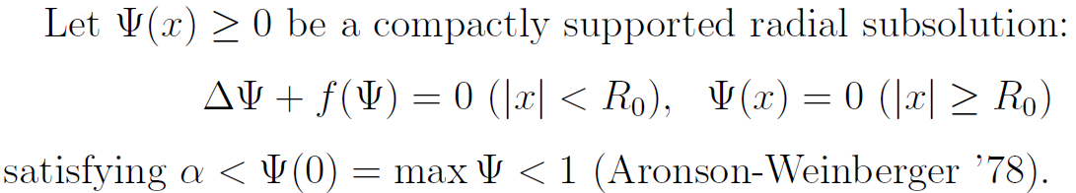
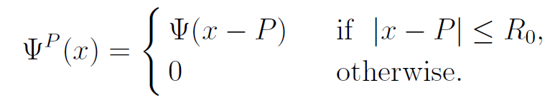

1. Wall with large holes
Theorem 6. If a ball of radius R₀ can pass through one of the holes of the wall without touching K, then propagation occurs .
1
f (u)
a
$$α$$
u
0
1
0
x
-R₀
R₀
Strong maximum principle + sweeping argument
K
Move the position of P continuously without hitting K

Slide 28
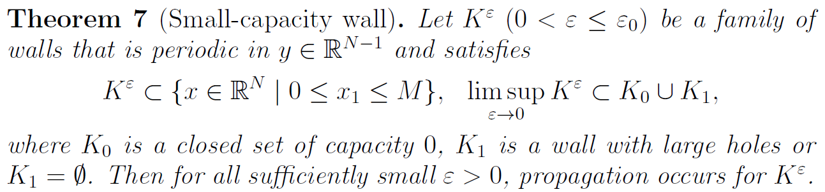
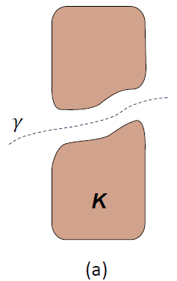
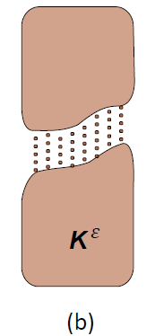
2. Small capacity wall
Wall with a large hole.
Wall with a large hole that is filled with debris of small capacity.

Slide 29

2. Small capacity wall
Sufficient conditions for capacity 0
Examples of K₀
Discrete set (N ≥ 2)
Locally finite union of curves (N = 3)
“Debris wall”
“Filament wall”

Slide 30
2. Small capacity wall
Idea of proof:
Limiting argument
+
Removable singularity
+
Dichotomy theorem
Corollary 3. The limit of a sequence of blocking walls is a blocking wall.
(Corollary 3)
Interpretation of the result
Since the front has positive thickness, it is not very sensitive to debris of small capacity.
front

Slide 31
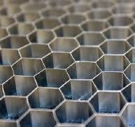
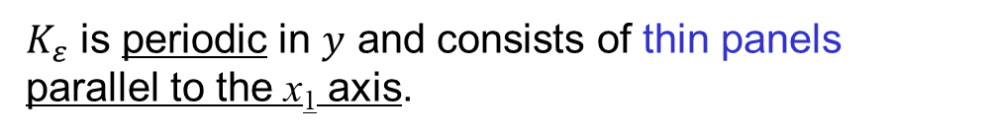
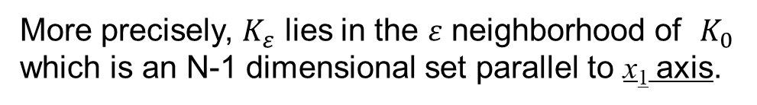
3. Parallel-blade wall
$K_{ε}$ is periodic in $y$ and consists of thin panels parallel to the x₁ axis.
More precisely, $K_{ε}$ lies in the $ε$ neighborhood of $K_{0}$ which is an N-1 dimensional set parallel to x₁ axis.
K_{ε}
K₀
Note: K₀ has positive capacity as codim K₀ =1
In 3D, a honeycomb wall is also an example.

Slide 32
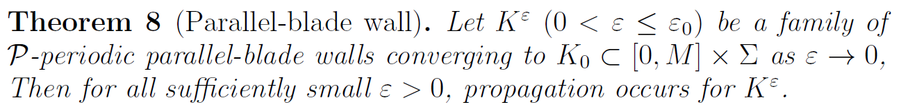
3. Parallel-blade wall
$K_{ε}$ is periodic in $y$ and consists of thin panels parallel to the x₁ axis.
More precisely, $K_{ε}$ lies in the $ε$ neighborhood of $K_{0}$ which is an N-1 dimensional set parallel to x₁ axis.
K_{ε}
K₀
Method: sweeping method by “quasi-subsolutions”
and relative Poincaré inequality

Slide 33
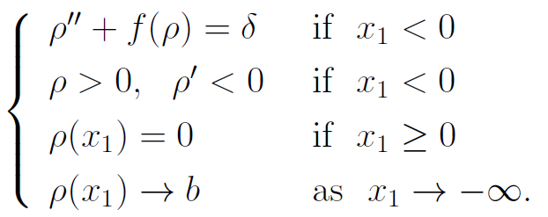



Strategy of proof: Sweeping argument by quasi-subsolutions.
Step 1
Define a function $ρ\left(x_{1}\right)$ on $ℝ$ by
1
b
$$ρ$$
0
Step 2

Slide 34






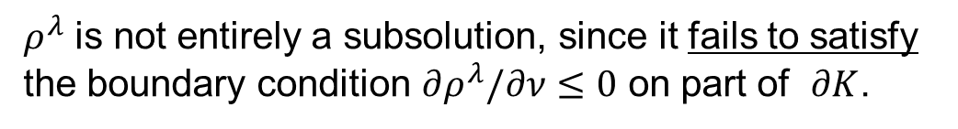
Step 2
Remark
$ρ^{λ}$ is not entirely a subsolution, since it fails to satisfy the boundary condition $∂ρ^{λ}/∂ν≤0$ on part of $∂K$.
$$K$$
$$K$$
Step 3
Define
unit periodicity cell
Relative Poincare inequality
This implis propagation, since otherwise $\left|D^{λ}\right|→∞$ as $λ→∞$ .

Slide 35

Relative Poincaré inequality
D
$$w=0$$

Slide 36


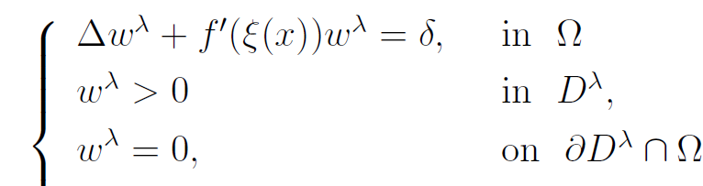
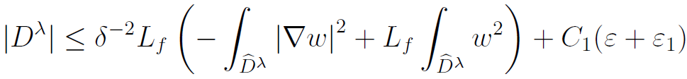
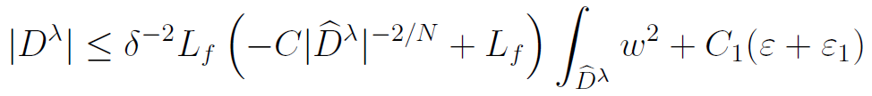
Step 3
Define
We show that
relative Poincaré inequality
Propagation

Slide 37
Summary:
We discussed whether or not a planar bistable front can propagate through a perforated wall.
Classification of general behavior:
Dichotomy theorem (via Liouville type lemma)
Cor. the limit of blocking walls is again blocking.
A sufficient condition for blocking: (narrow holes)
Method: construction of an upper barrier via a variational argument
Three sufficient conditions for propagation:
(a) large-hole walls (b) small-capacity walls (c) parallel-blade walls.
Method: (a) sweeping method, (b) removable singularity theory +
dichotomy thm, (c) sweeping by quasi-subsolutions.

Slide 38
Open questions:
Tilted thin panels:
What if the panels are tilted ?
2. Proof of blocking for non-periodic walls
Is there a way to apply variational arguments?
3. Homogenization problem:
What if the size of the holes and
the distance between adjacent holes
both go to zero simultaneously?

Slide 39
Thank you!

